Slide 1
Opentrons OT-2
Summer Progress with Matus Kordos & Oliver Vanderwal

Slide 2
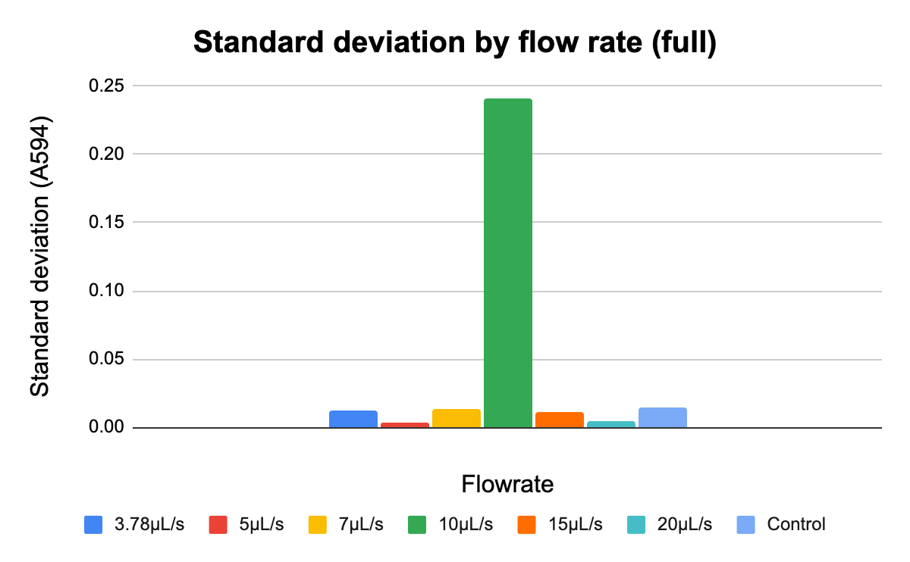
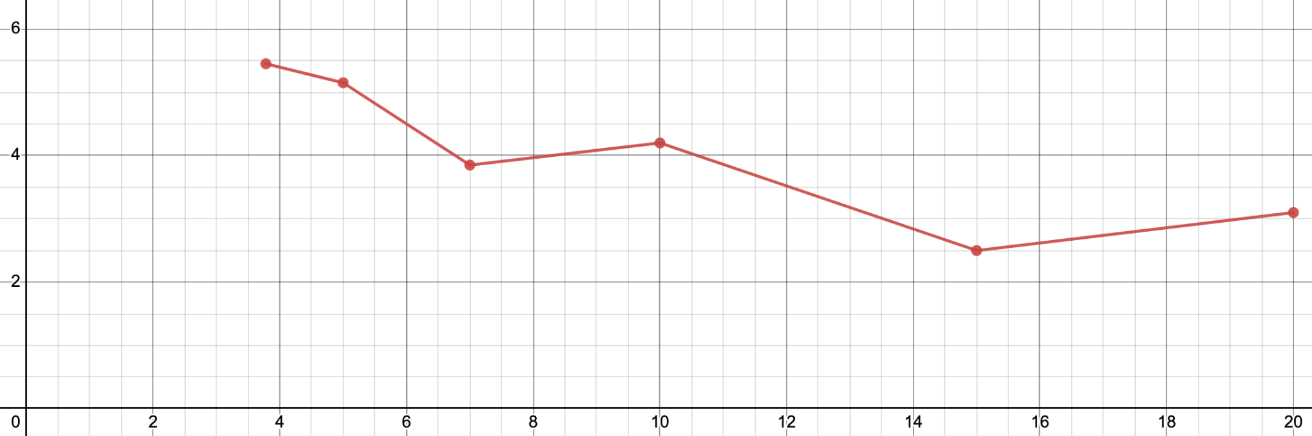
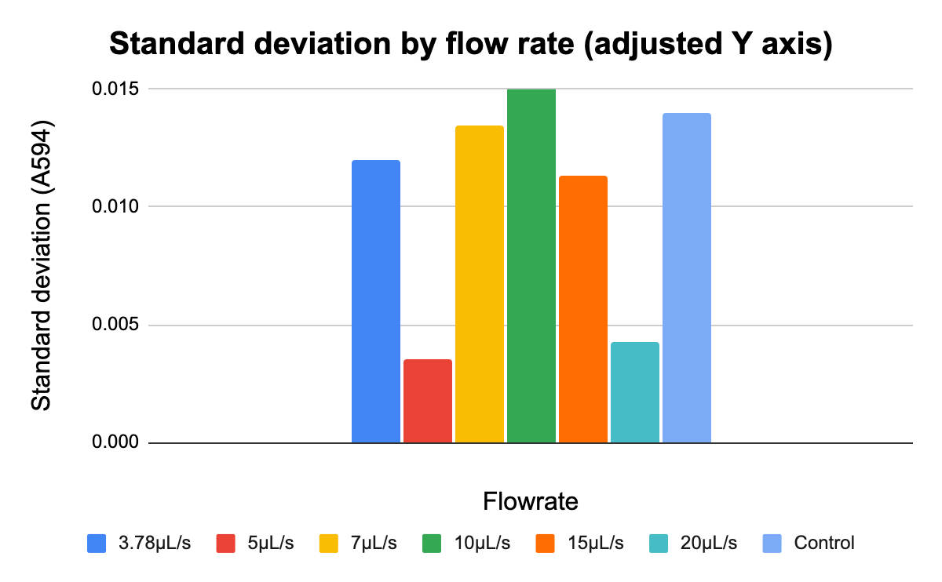
Changing dispensing settings vs. flow rate
07/12/2023
Average A594 with and without blowout vs flowrate
Average A594
Flowrate (µL/s)
control 1 | control 2 | control3 | AVG | STDEV
0.42 | 0.405 | 0.392 | 0.40567 | 0.014012
Flow rate (µL/s) | 3.78 | 5 | 7 | 10 | 15 | 20 | AVG | STDEV
w/o blowout | 0.396 | 0.399 | 0.398 | 0.051 | 0.367 | 0.384 | 0.3325 | 0.13844
w/ blowout | 0.413 | 0.404 | 0.379 | 0.392 | 0.383 | 0.378 | 0.3915 | 0.01435
AVG | 0.4045 | 0.4015 | 0.3885 | 0.2215 | 0.375 | 0.381 | TOTAL AVG | TOTAL STDEV
STDEV | 0.01202 | 0.00354 | 0.01344 | 0.24112 | 0.01131 | 0.004242 | 0.362 | 0.09877
Notes:
Protocol and data name (in the google drive): FlowRateBlowoutTest
Description: [7/12/2023]
A simple protocol for testing out different flow rates along with the blowout feature.
Flowrates (by column): default (3.78 ul/s), 5 ul/s, 7 ul/s, 10 ul/s, 15 ul/s, 20 ul/s.
Row A is without blowout, row B is with blowout.
Conclusion:
the control measurements were done by Katrina
the robot’s accuracy is mostly better than a human’s with the exception of the A4 well (green column), where the robot sucked most of the dye back in the pipette tip and dropped it outside of the wellplate
the average plot displays a negative trend in absorption with rising flowrate, indicating less dye being transferred over and presumably more getting left in the tip

Slide 3
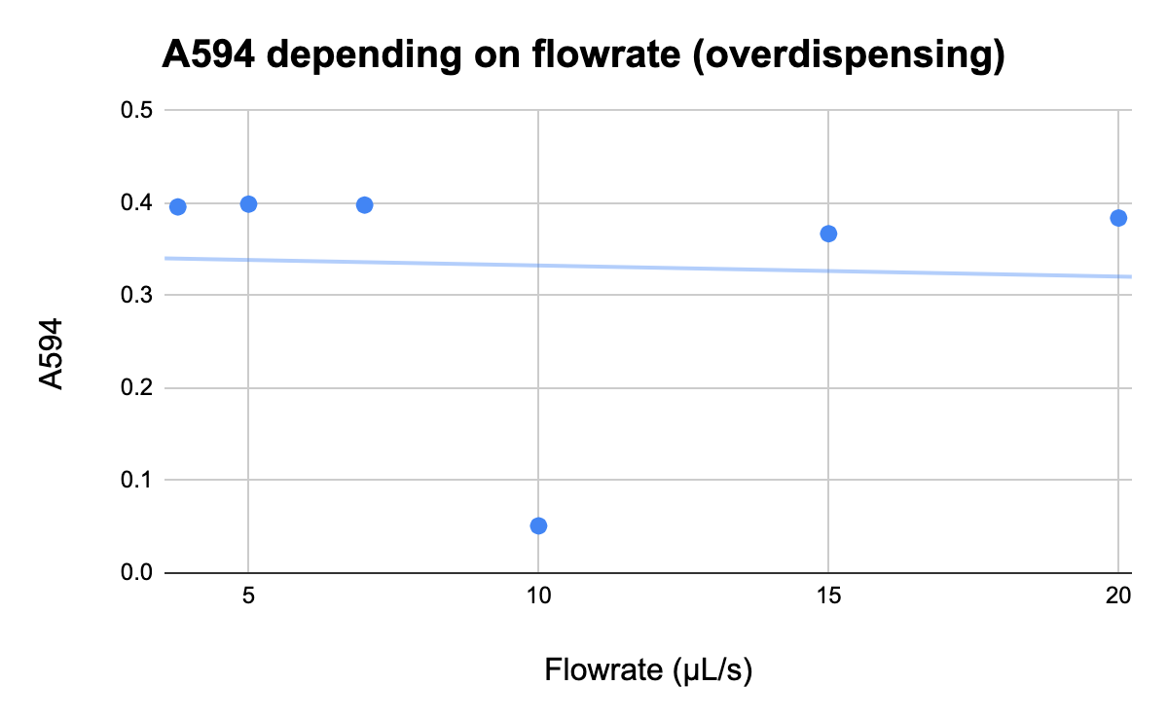
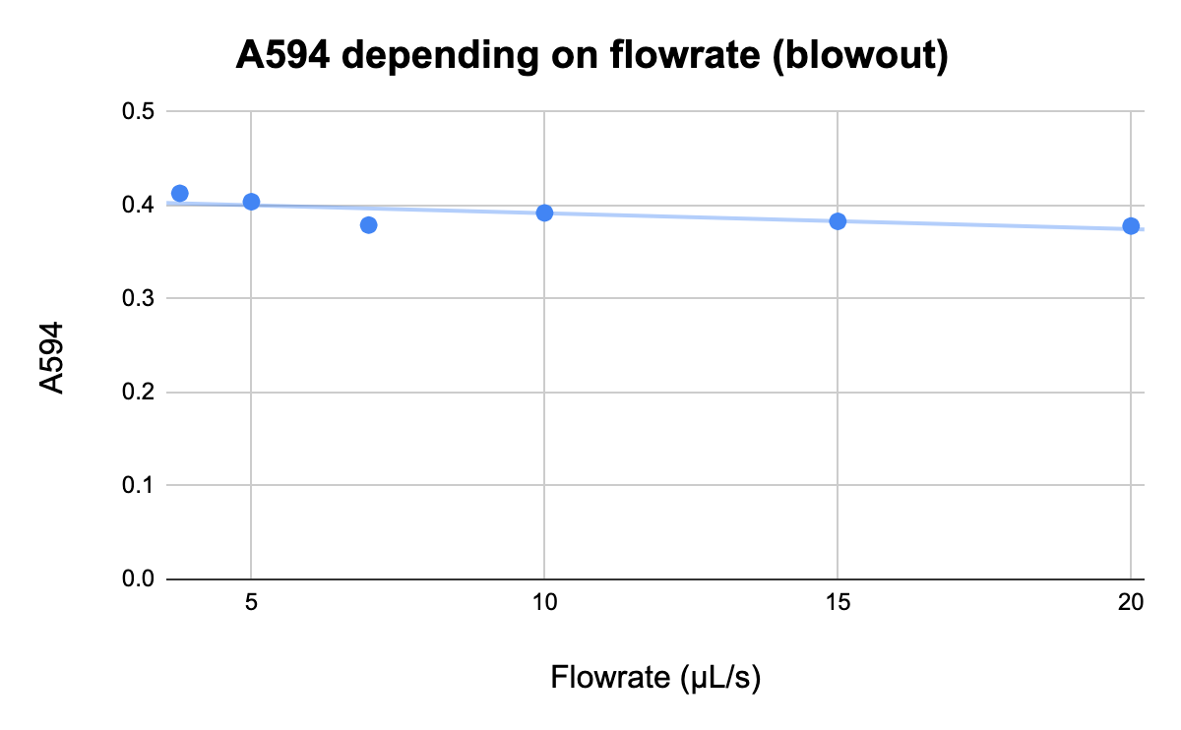
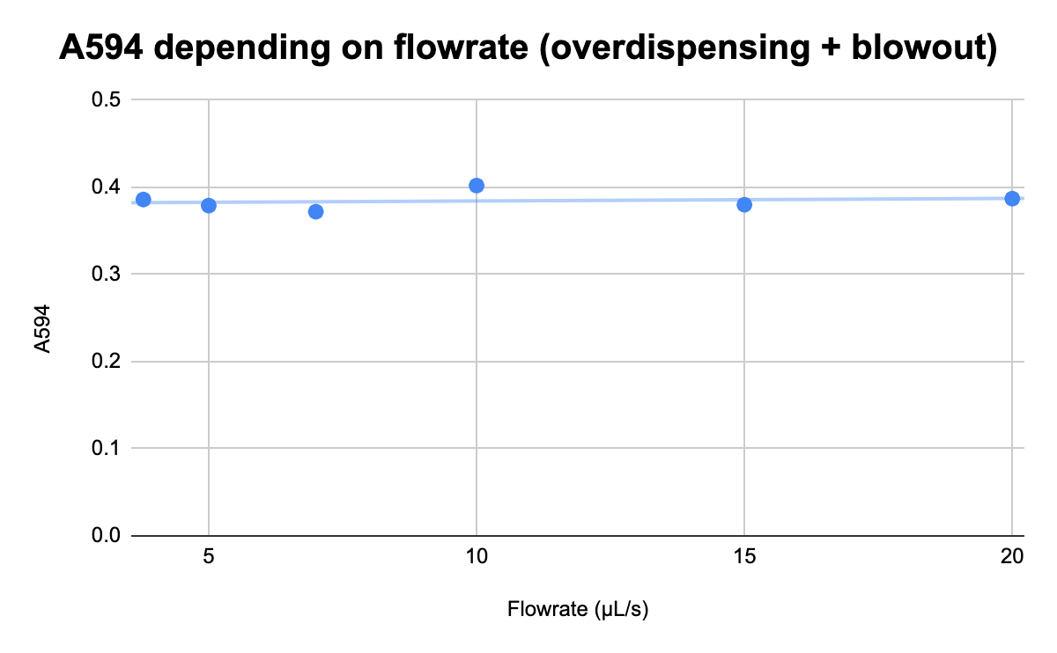
Changing dispensing settings vs. flow rate
07/12/2023-07/13/2023
Notes:
Protocol and data name (in the google drive): EnhancedDispenseTest
Description: [7/13/2023]
Testing an alternate approach attempting to minimize the amount of liquid left in the tip after dispensing, with changing flowrate.
Flowrates (by column): default (3.78 ul/s), 5 ul/s, 7 ul/s, 10 ul/s, 15 ul/s, 20 ul/s.
Conclusion:
the control measurements were done by Katrina again
both the graphs from the previous run display a negative trend with increasing flowrate, indicating less dye getting transported, while this run’s graph has an almost flat trendline, which means in this case the flowrate doesn’t affect the precision, allowing us to use a higher flowrate to save time without experiencing significant drops in accuracy
lowering the tip from 5mm above the bottom of the well to just 1mm eliminated some surface tension issues causing liquid to stay in the tip, but resulted in bubbles creating in the well, so we will probably settle on a height of about 2mm above the bottom

Slide 4
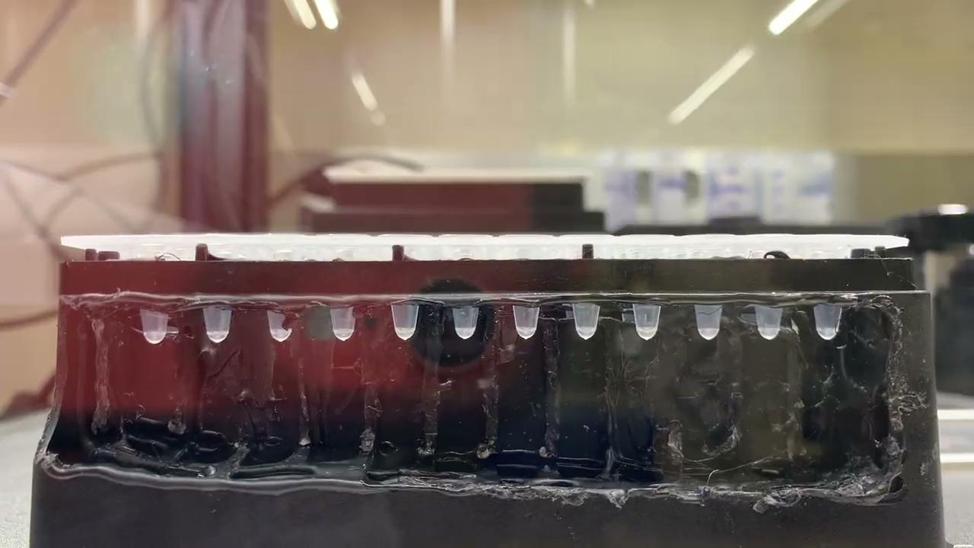
Varying height of the tip and blowout flow rate
Notes:
Protocol and data name (in the google drive): BlowoutHeightTest
Description: [7/14/2023]
Testing how the distance of the tip from the bottom of the well and blow-out flowrate influence bubble creation
(heights: 0mm, 0.5mm, 1mm, 2mm) (flow rates: 10µL/s, 15µL/s, 20µL/s)
Conclusion:
most significant bubbles were created at 2mm
the tip slightly collided with the well at 0mm and 0.5mm
1mm was very smooth, without bubbles, and didn’t collide with the well, so it is the most optimal out of the 4 (no bubbles appeared even at 20µL/s, so we will use it because it takes the shortest)

Slide 5
The framework
main library: KineticsEngine
provides basic structures and commands to simplify protocol syntax for kinetics experiments
front-end:
class: KineticsTemplate
stores the layout and base data
class: KineticsInstance
a single experiment - template placed in a specific position
back-end (created internally by KineticsTemplate):
class: KineticsLayout
abstract destination well management class
class KineticsSources
abstract source well management class

Slide 6
How it works
you create a virtual template instance which can be instantiated anywhere (KineticsTemplate)
the template automatically calculates all the positions using a KineticsLayout object
you create an instance of your template at a specific position (KineticsInstance)
the robot automatically sets up all the wells when the instance is created, but the actual experiment must be started with a separate command, KineticsInstance.execute() (or by calling the instance as a function)
the experiment is run with a single, blocking function call

